Slide 1
Developing With Android
Dustin R. Welden
ACM Wichita
22 September 2010

Slide 2
What is Android?
Linux-based operating system
Mobile OS
Tablets

Slide 3
Roadmap
Brief History
Android Architecture
Putting it in Practice
Future Development

Slide 4
Brief History
Android, Inc. formed in Palo Alto, CA
Google acquires Android, Inc.
Speculations
Rumors Valid
HTC introduces the Dream
A.K.A. T-Mobile G1
First Android phone
Late 2003
July 2005
October 2008

Slide 5
Adoption Rates
Source: Gartner (August 2010)

Slide 6
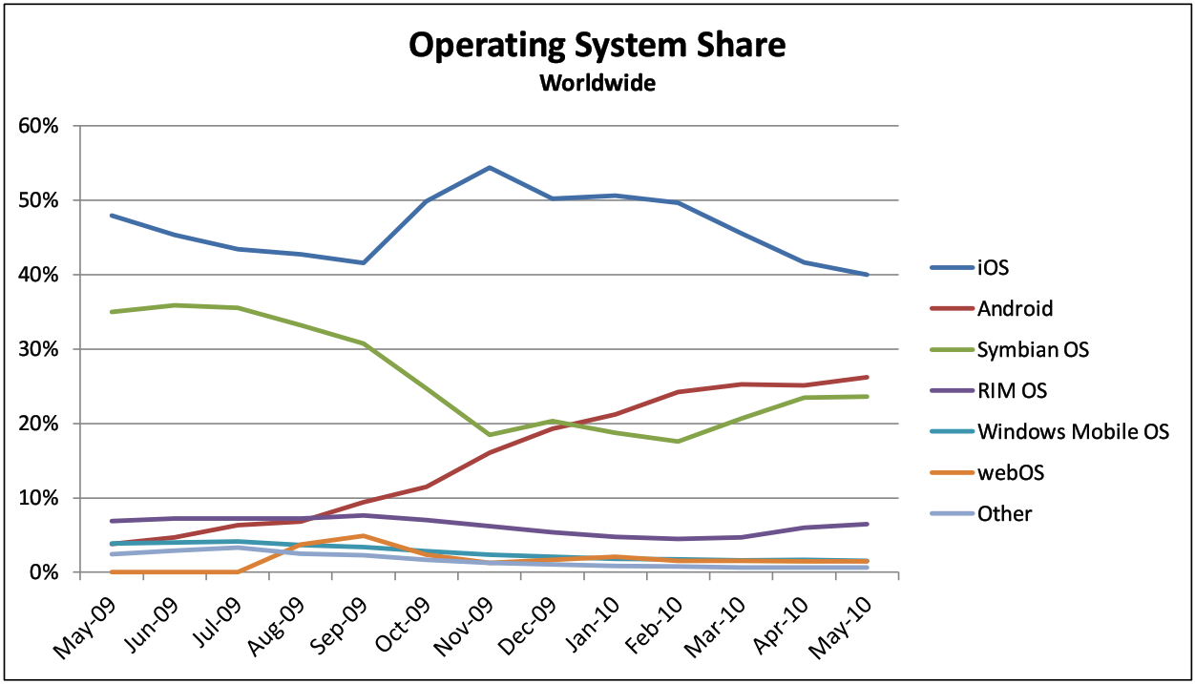
(Source: AdMob, May 2010)

Slide 7
Why Android?
Open Source
Open Market
Revenue is Good

Slide 8
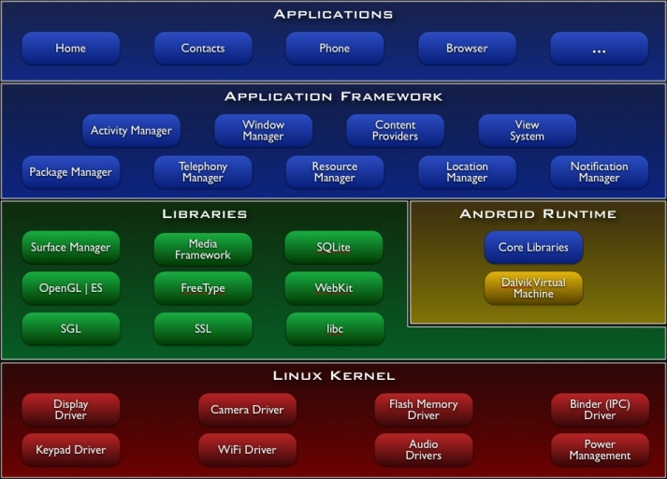
Android Architecture
Source: developer.android.com

Slide 9
Application Components
Activities
Services
Broadcast Receivers
Content Resolvers

Slide 10
Activities
Holds a View
Usually XML-based
UI starting point

Slide 11
Dive Into Code

Slide 13
Resources
Presentation Materials:
http://github.com/drwelden/Android-Presentation

